Slide 1


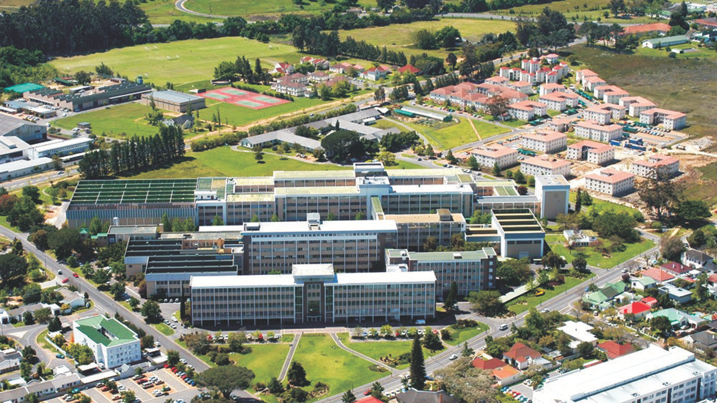

Real-time 3D Biomechanical Analysis and AI Personal Trainer for Strength And Conditioning Exercises Using Markerless Motion Capture
Rensu P Theart, Lizé Steyn, Keagan Ellenberger, Chris-Mari Schreuder
Photo by Stefan Els
Engineering · EyobuNjineli · Ingenieurswese
Notes:
Good [morning/afternoon], today I’ll present work on real-time 3D biomechanical analysis and an AI personal trainer using markerless motion capture. This is based on Masters work I supervised, conducted by Lize Steyn

Slide 2
Current Limitations in Motion Analysis
Traditional 3D motion capture systems are expensive
Require specialised laboratory environments
Limited accessibility for athletes and trainers
The gap between research-grade analysis and practical application
Engineering · EyobuNjineli · Ingenieurswese
Notes:
“Traditional 3D motion capture is accurate but expensive, needs labs, and is not accessible to gyms or athletes. Our goal: close the gap between research-grade analysis and practical, affordable tools.”

Slide 3
Markerless Motion Capture System
Our System Requirements
Real-time 3D biomechanical feedback
Low-cost webcam setup (3 cameras)
No markers or specialized equipment required
Accessible for gyms, clinics, and home use
Engineering · EyobuNjineli · Ingenieurswese
Notes:
“We use three low-cost webcams, no markers or specialized suits. This makes the system accessible in gyms, clinics, or even at home.”

Slide 4
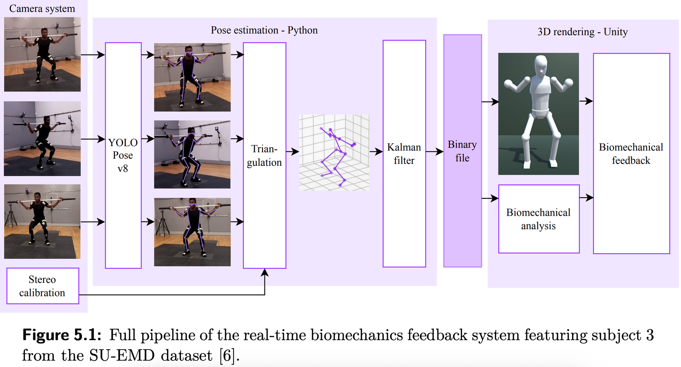
System Architecture
Input: Multi-angle 2D video from 3 webcams
Engineering · EyobuNjineli · Ingenieurswese
Notes:
Input: ‘We capture synchronized video from 3 webcams.’

Slide 5
System Architecture
Processing: 5 pose estimation models tested (YOLOv8, OpenPose, etc.)
Engineering · EyobuNjineli · Ingenieurswese
Notes:
Processing: ‘We tested five state-of-the-art pose estimation models, including OpenPose and YOLOv8.’

Slide 6
System Architecture
Reconstruction: Stereo triangulation for 3D coordinates
Engineering · EyobuNjineli · Ingenieurswese
Notes:
Reconstruction: ‘2D keypoints from each camera are triangulated into 3D coordinates.’

Slide 7
System Architecture
Smoothing: Kalman filter for stability
Engineering · EyobuNjineli · Ingenieurswese
Notes:
Smoothing & Output: ‘We use a Kalman filter for stability, and visualize in real time using Unity.’

Slide 8
System Architecture
Output: Real-time Unity visualisation
Engineering · EyobuNjineli · Ingenieurswese

Slide 9
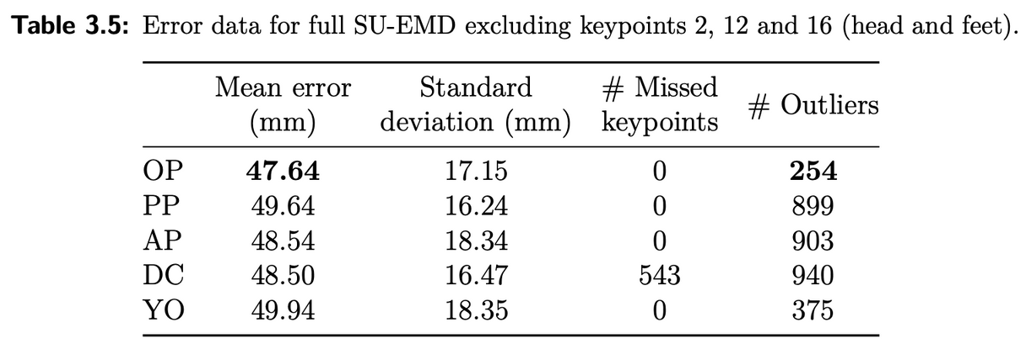
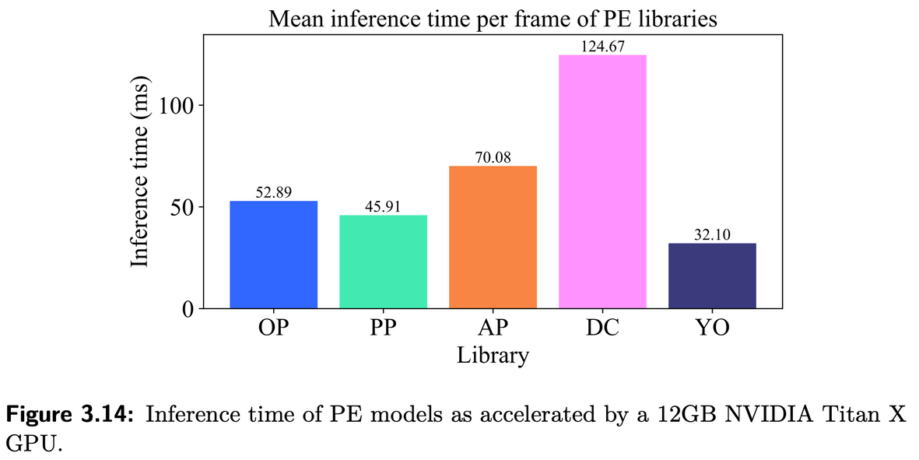
Pose Estimation Model Performance
Tested 5 state-of-the-art models
Winner: YOLOv8m-pose
Accuracy: 49.94mm mean error
Speed: 32.10ms per frame (real-time capable) ≈ 30 FPS
On Titan X (2015) GPU
Best speed-accuracy trade-off
Engineering · EyobuNjineli · Ingenieurswese
Notes:
“We benchmarked five models. The winner: YOLOv8m-pose with ~50 mm mean error and 32 ms/frame latency. This gave the best speed–accuracy trade-off for real-time use.”

Slide 10
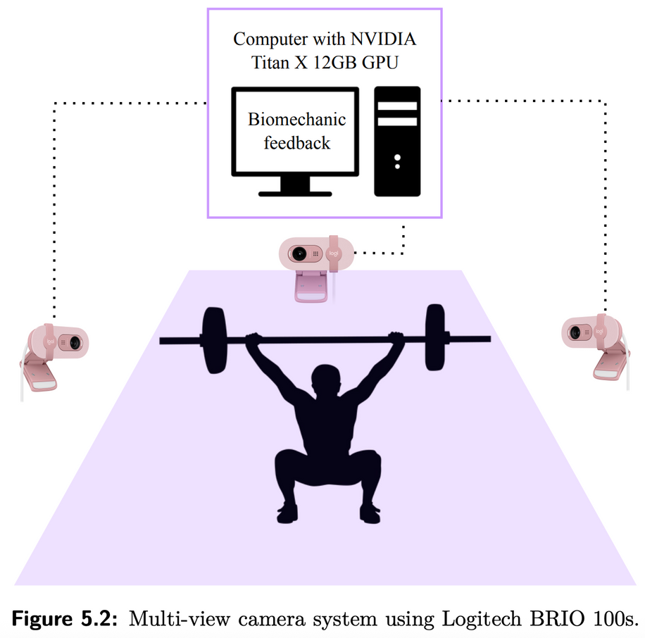
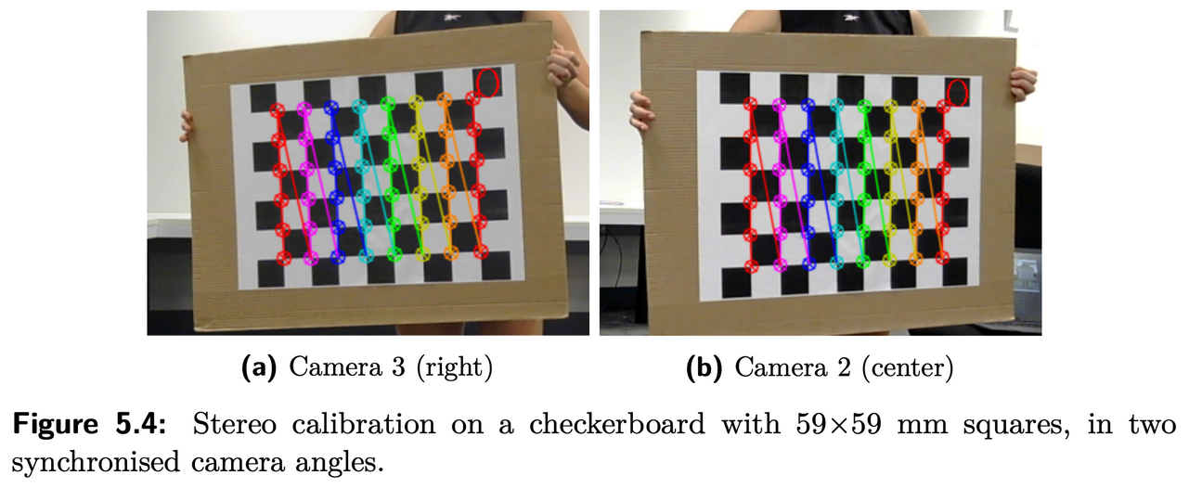
Real-Time System Design
Web-cam system
Camera calibration
YOLOv8m-pose model generates 2D keypoints
Triangulate 3D keypoints
Engineering · EyobuNjineli · Ingenieurswese
Notes:
Webcam system + calibration → YOLOv8 keypoints → triangulation.

Slide 11
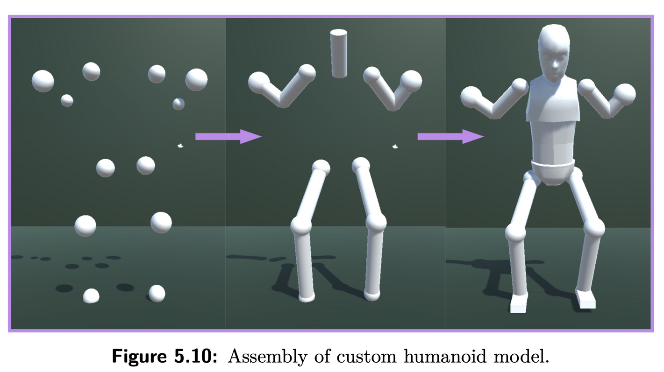
Real-Time System Design
Import 3D keypoints to Unity
Construct segments
Generate a full humanoid model
Engineering · EyobuNjineli · Ingenieurswese
Notes:
Unity builds the full humanoid model.

Slide 12
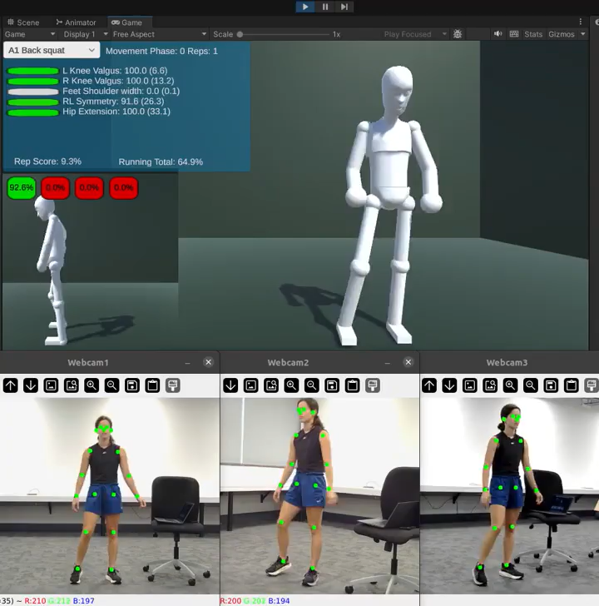
Real-Time System Performance
Engineering · EyobuNjineli · Ingenieurswese
Notes:
“In summary:
Low-cost webcams replace expensive lab systems.
~50 mm accuracy, real-time speed.
Provides immediate feedback for athletes. This work demonstrates how markerless AI-driven systems can make biomechanical training more accessible and scalable.”

Slide 13
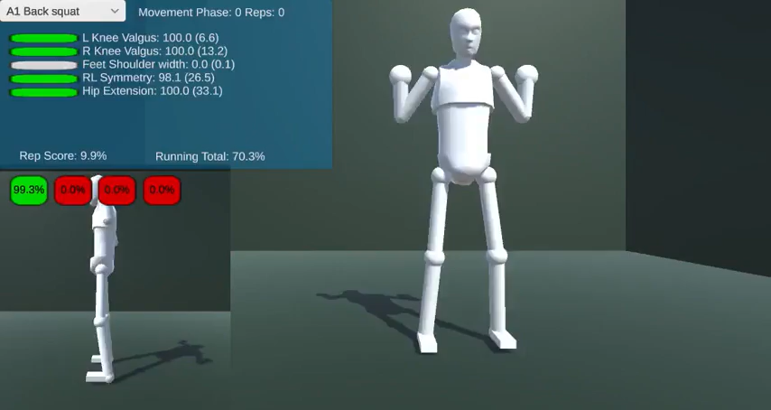
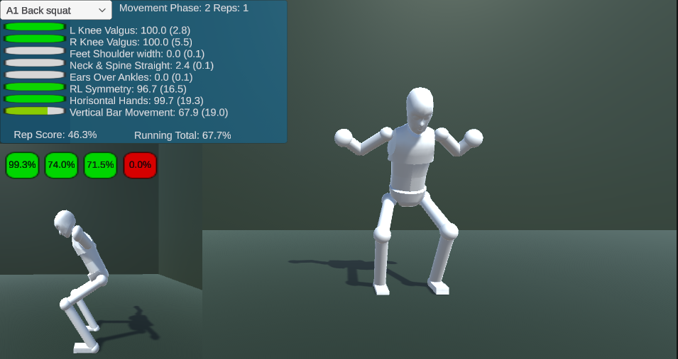
Real-Time System Design
Exercise Selection: 7 strength exercises supported
Form Analysis: Joint angles, symmetry, alignment
Real-Time Scoring: Performance metrics with colour coding
Rep Counting: Automatic repetition detection
Instant Feedback: Visual and numerical guidance
Engineering · EyobuNjineli · Ingenieurswese
Notes:
Exercises supported: 7 strength movements. We analyze joint angles, symmetry, and alignment, give scores and rep counts, and provide instant feedback.”

Slide 14
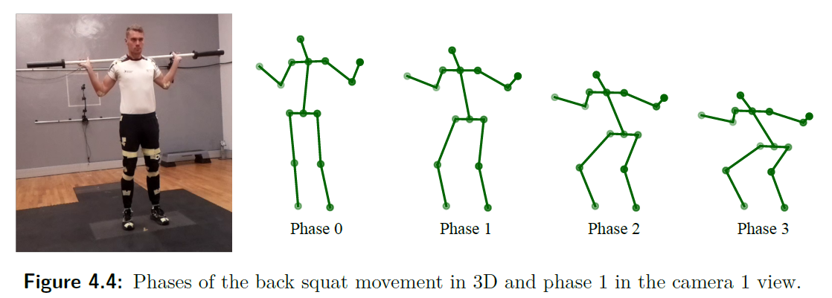
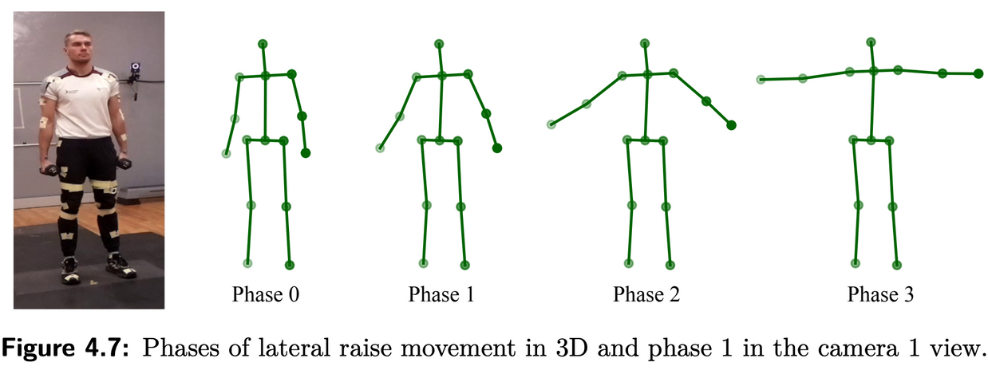
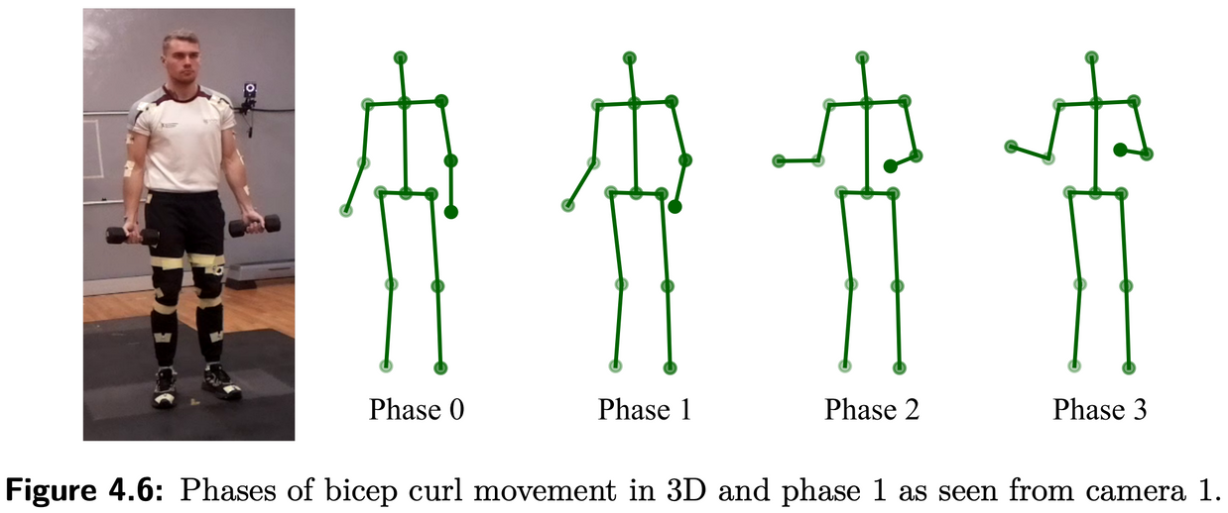
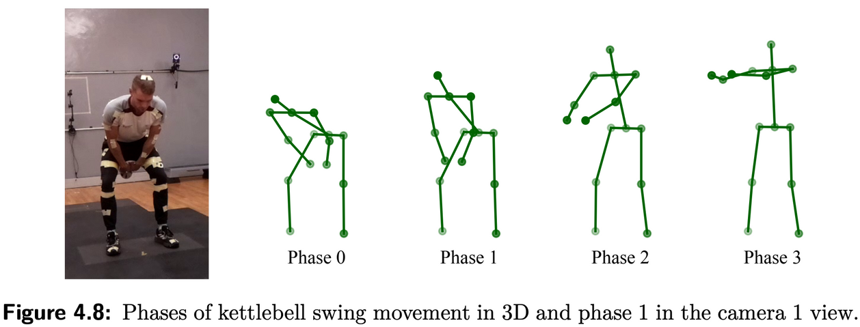
Real-Time System Design
Engineering · EyobuNjineli · Ingenieurswese
Notes:
“The system provides phase tracking, rep scores, and an overall movement score with colour-coded feedback. This mimics what a real trainer would highlight during a workout.”

Slide 15
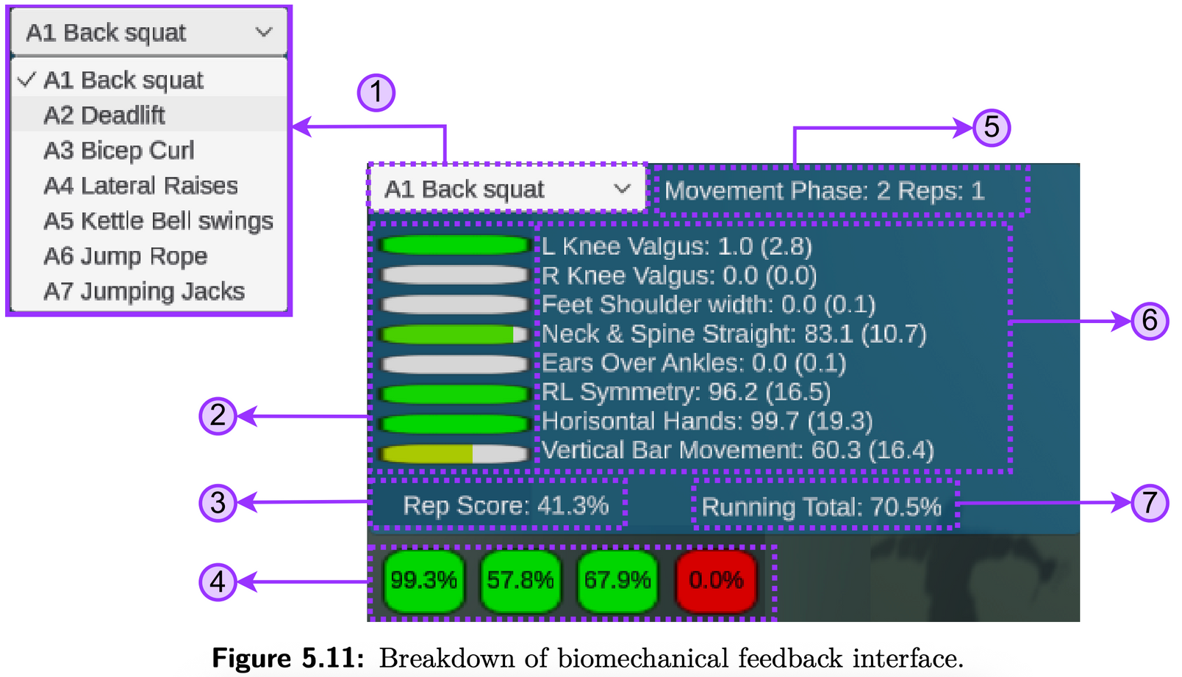
Real-Time System Design
1
5
Action selection
Full range of motion percentage
Rep score
Phase score
Phase and rep tracking
Segmented results
Total movement score
6
2
3
7
4
Engineering · EyobuNjineli · Ingenieurswese
Notes:
“The system runs real-time on standard hardware. Performance depends somewhat on video quality and lighting, but results are consistent within tested setups.”

Slide 16
Current Challenges
Limitations
Future Directions
Video quality dependency
Limited to tested exercises
Need for broader population validation
Machine learning pose refinement
Expanded exercise database
Clinical validation studies
Engineering · EyobuNjineli · Ingenieurswese

Slide 17
Key Takeaways
Cost-effective: Uses standard webcams instead of specialised equipment
Performance: 50mm accuracy with 32ms processing speed per frame
Immediate feedback: Real-time form correction and scoring
Portable setup: Works in any environment with proper lighting
User-friendly: No markers or technical expertise required
Engineering · EyobuNjineli · Ingenieurswese
Notes:
“Thank you for your attention. I’d be glad to take any questions.”

Slide 18
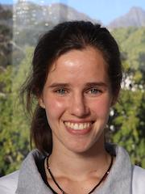

Acknowledgements
Lizé Steyn
Chris-Mari Schreuder
Engineering · EyobuNjineli · Ingenieurswese
Notes:
“Thank you for your attention. I’d be glad to take any questions.”

Slide 19
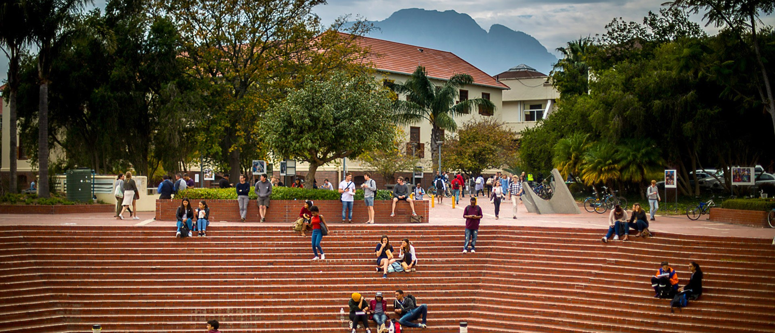
Thank you
Enkosi
Dankie
Engineering · EyobuNjineli · Ingenieurswese
Notes:
“Thank you for your attention. I’d be glad to take any questions.”

Slide 20
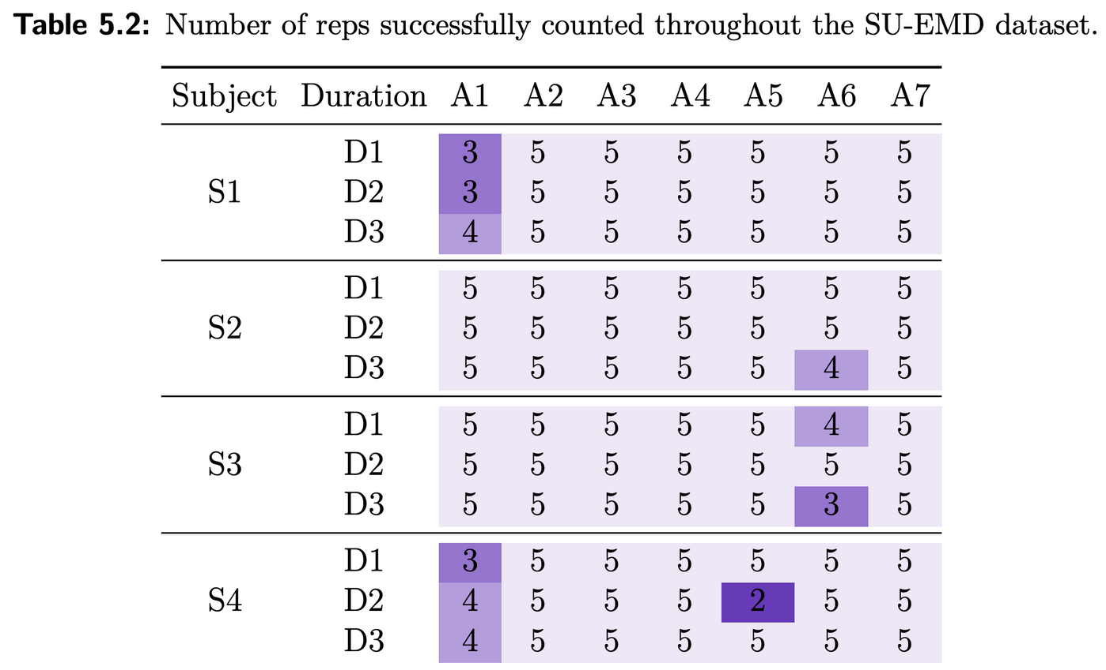
Real-Time System Performance
Engineering · EyobuNjineli · Ingenieurswese
Notes:
“Limitations: currently only tested on 7 exercises, depends on camera quality, and needs validation on a wider population. Future: refine machine learning models, expand the exercise library, and test in clinical/rehabilitation contexts.”

Slide 21
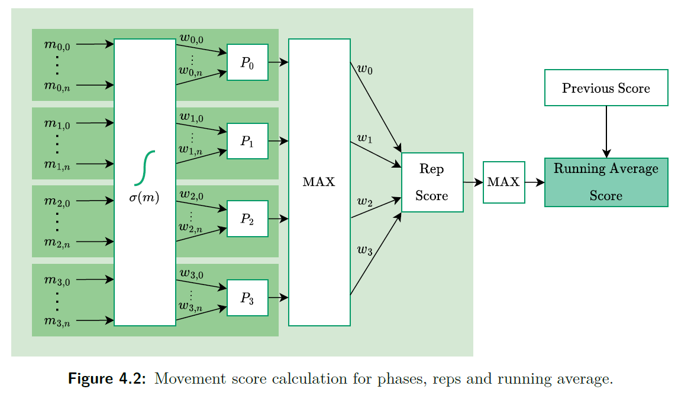
Movement Score Calculation
Engineering · EyobuNjineli · Ingenieurswese
Notes:
“Thank you for your attention. I’d be glad to take any questions.”

