Slide 1
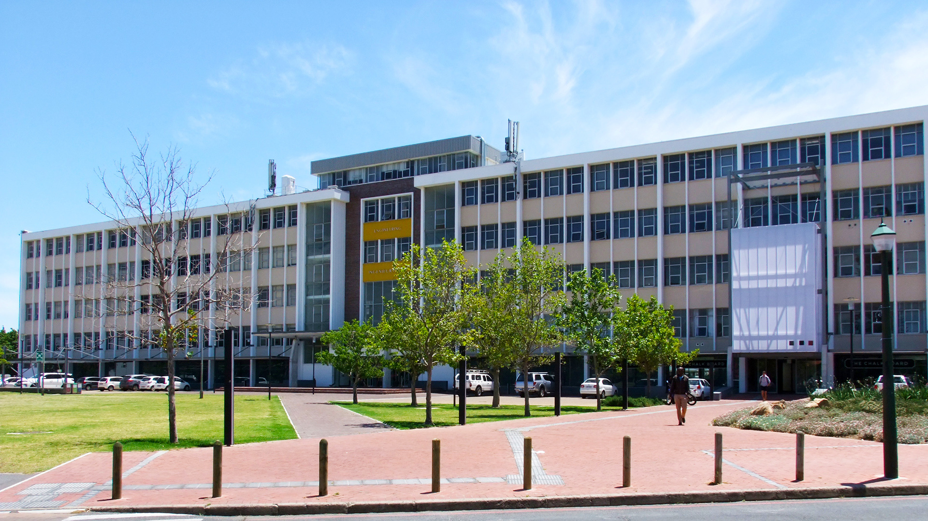




EVALUATING 2D POSE ESTIMATION MODELS FOR BIOMECHANICAL ANALYSIS USING A
HIGH-FIDELITY DATASET
Photo by Stefan Els
4th Conference of the South African Society of Biomechanics
Chris-Mari Schreuder1, Rynhard Fourie1, Oloff Bergh2, Rensu P. Theart¹
1 Electrical and Electronic Engineering, Stellenbosch University, Stellenbosch, South Africa
2 Neuromechanics Unit, Central Analytical Facility, Stellenbosch University, South Africa
Engineering · EyobuNjineli · Ingenieurswese
Notes:
Good morning everyone.
I'm Chris-Mari Schreuder from Stellenbosch University.
Today I'm going to tell you about our journey to answer a deceptively simple question:
Can we make computers see human movement as accurately as expensive motion capture systems?
Spoiler: we can get surprisingly close, and the results might change how we think about movement analysis outside the lab.

Slide 2


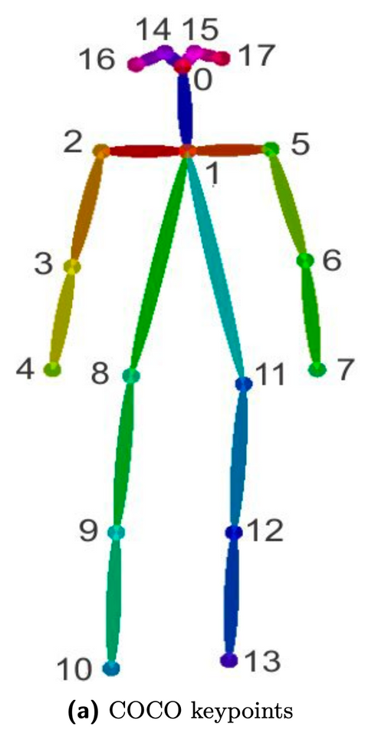
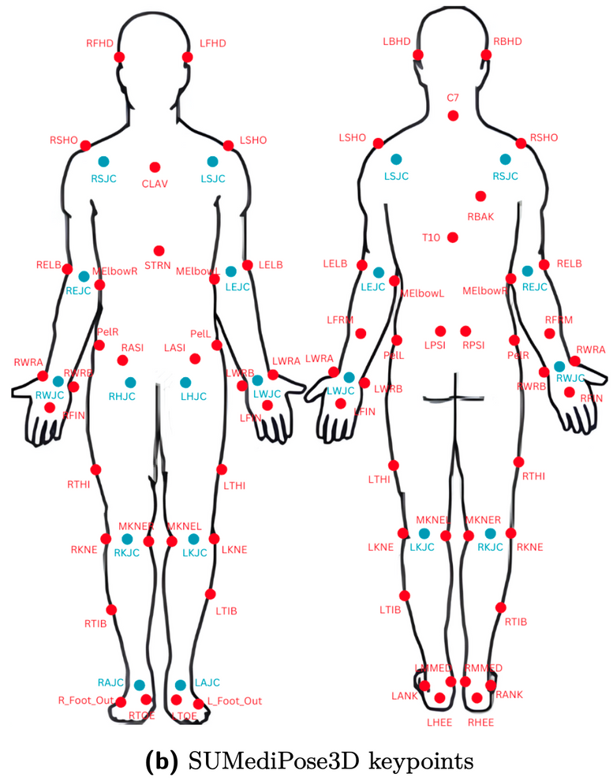
Current Limitations in Movement Analysis
  Marker-based systems: costly, complex, lab-restricted
  Existing 2D models: sparse keypoints (17), general-purpose data
  Gap: Need for clinically relevant, dense keypoint analysis
Engineering · EyobuNjineli · Ingenieurswese
Notes:
Let's start with the elephant in the room.
Traditional marker-based motion capture systems are the gold standard for biomechanical analysis - and they're also expensive, complex, and confined to laboratory settings.
Meanwhile, existing 2D pose estimation models give us these sparse 17 keypoints that work great for "person detected" but fall short when you need to assess whether someone's squat technique might lead to injury.

Slide 3
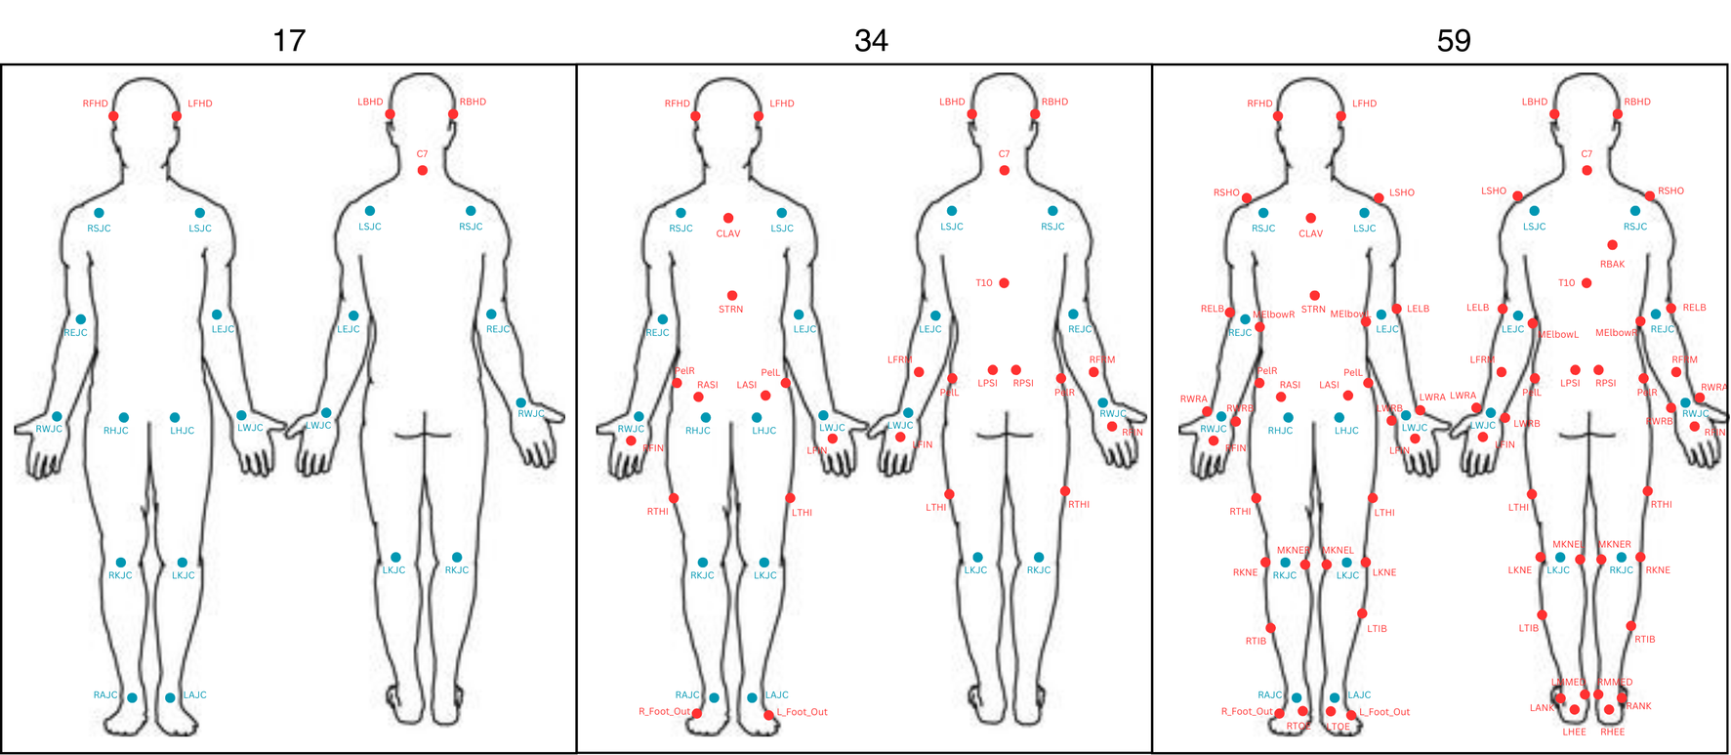
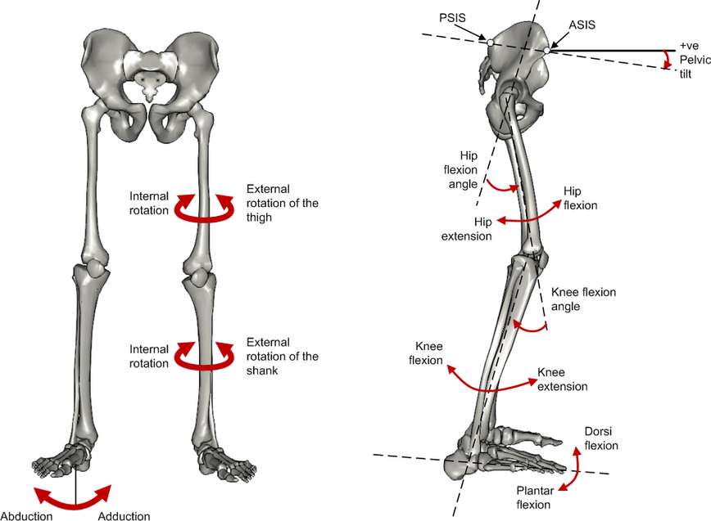
Research Goal
Can we perform biomechanical analysis?
Increase keypoint complexity
Engineering · EyobuNjineli · Ingenieurswese
Notes:
So our research goal was straightforward: progressively increase keypoint complexity from the standard 17 points to 34, then to 59 anatomically relevant points.
But the real question was whether we could perform meaningful biomechanical analysis with the results.

Slide 4
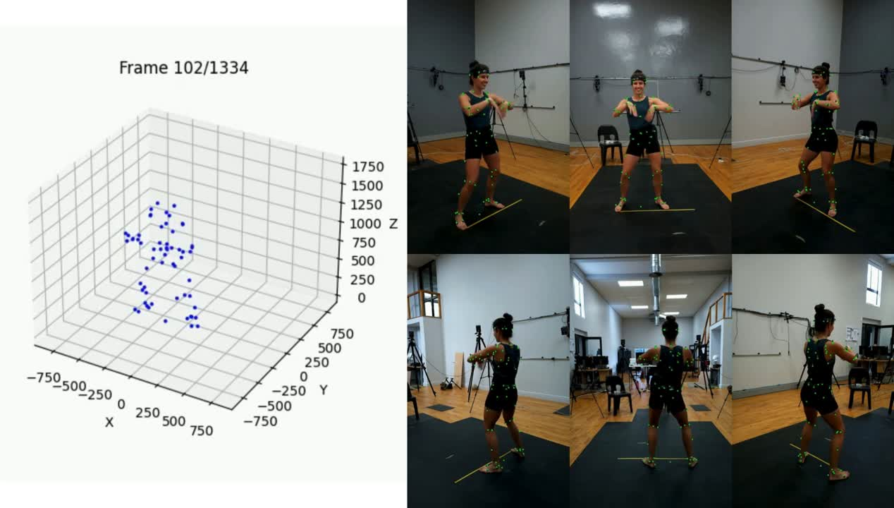
SUMediPose Data Example
Engineering · EyobuNjineli · Ingenieurswese
Notes:
This brings us to our secret weapon: the SUMediPose dataset.
Over 3 million images, 26 subjects, 63 keypoints captured with high-fidelity motion capture across recordings of several different exercises including squats, lunges, push-ups, and functional movements
Here's what real data looks like - simultaneous capture from multiple angles showing the same movement. This isn't just another computer vision dataset; it's biomechanically grounded data that lets us validate whether our AI actually understands human movement.

Slide 5
Method: Overview
  Models:
    HRNet: CNN + heatmap-based
    ViTPose: Transformer-based model
    YOLO-Pose: CNN + regression-based
  Dataset: SUMediPose (3M+ images, 26 subjects, 63 keypoints)
  Configurations: 17, 34, 59 keypoint progressions
  Evaluation: 2D accuracy → 3D reconstruction → joint angles
Finetune models on SUMediPose
Engineering · EyobuNjineli · Ingenieurswese
Notes:
Our methodology followed a logical progression.
We selected three representative architectures: HRNet with its CNN and heatmap approach; ViTPose using transformers and YOLO-Pose with regression
.
We fine-tuned these models on SUMediPose using three keypoint configurations: 17, 34, and 59 points.
Then came the real test - could these 2D predictions hold up when we reconstructed them in 3D and calculated actual joint angles?

Slide 6
Method: Overview
  Models:
    HRNet: CNN + heatmap-based
    ViTPose: Transformer-based model
    YOLO-Pose: CNN + regression-based
  Dataset: SUMediPose (3M+ images, 26 subjects, 63 keypoints)
  Configurations: 17, 34, 59 keypoint progressions
  Evaluation: 2D accuracy → 3D reconstruction → joint angles
Finetune models on SUMediPose
Predict 2D human keypoints
3D keypoint reconstruction
Biomechanical analysis
Engineering · EyobuNjineli · Ingenieurswese
Notes:
Our evaluation pipeline went from 2D accuracy to 3D reconstruction to biomechanical analysis. Because ultimately, we don't just care if the computer can find a knee - we care if it can tell us how that knee is moving.

Slide 7
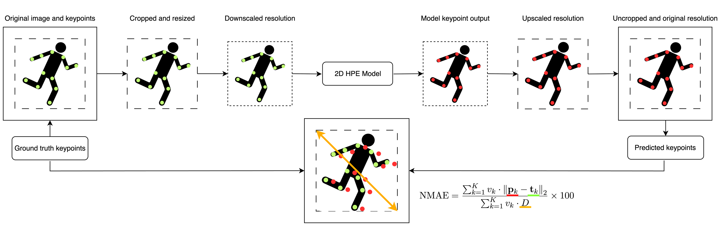
Method: 2D Evaluation
Engineering · EyobuNjineli · Ingenieurswese
Notes:
Here's how we validated our 2D predictions
- we fed original images through our models and compared predicted keypoints against ground truth using NMAE, our resolution-independent metric.
NMAE normalizes errors to the person's bounding box, making results comparable across different image sizes and distances from camera

Slide 8
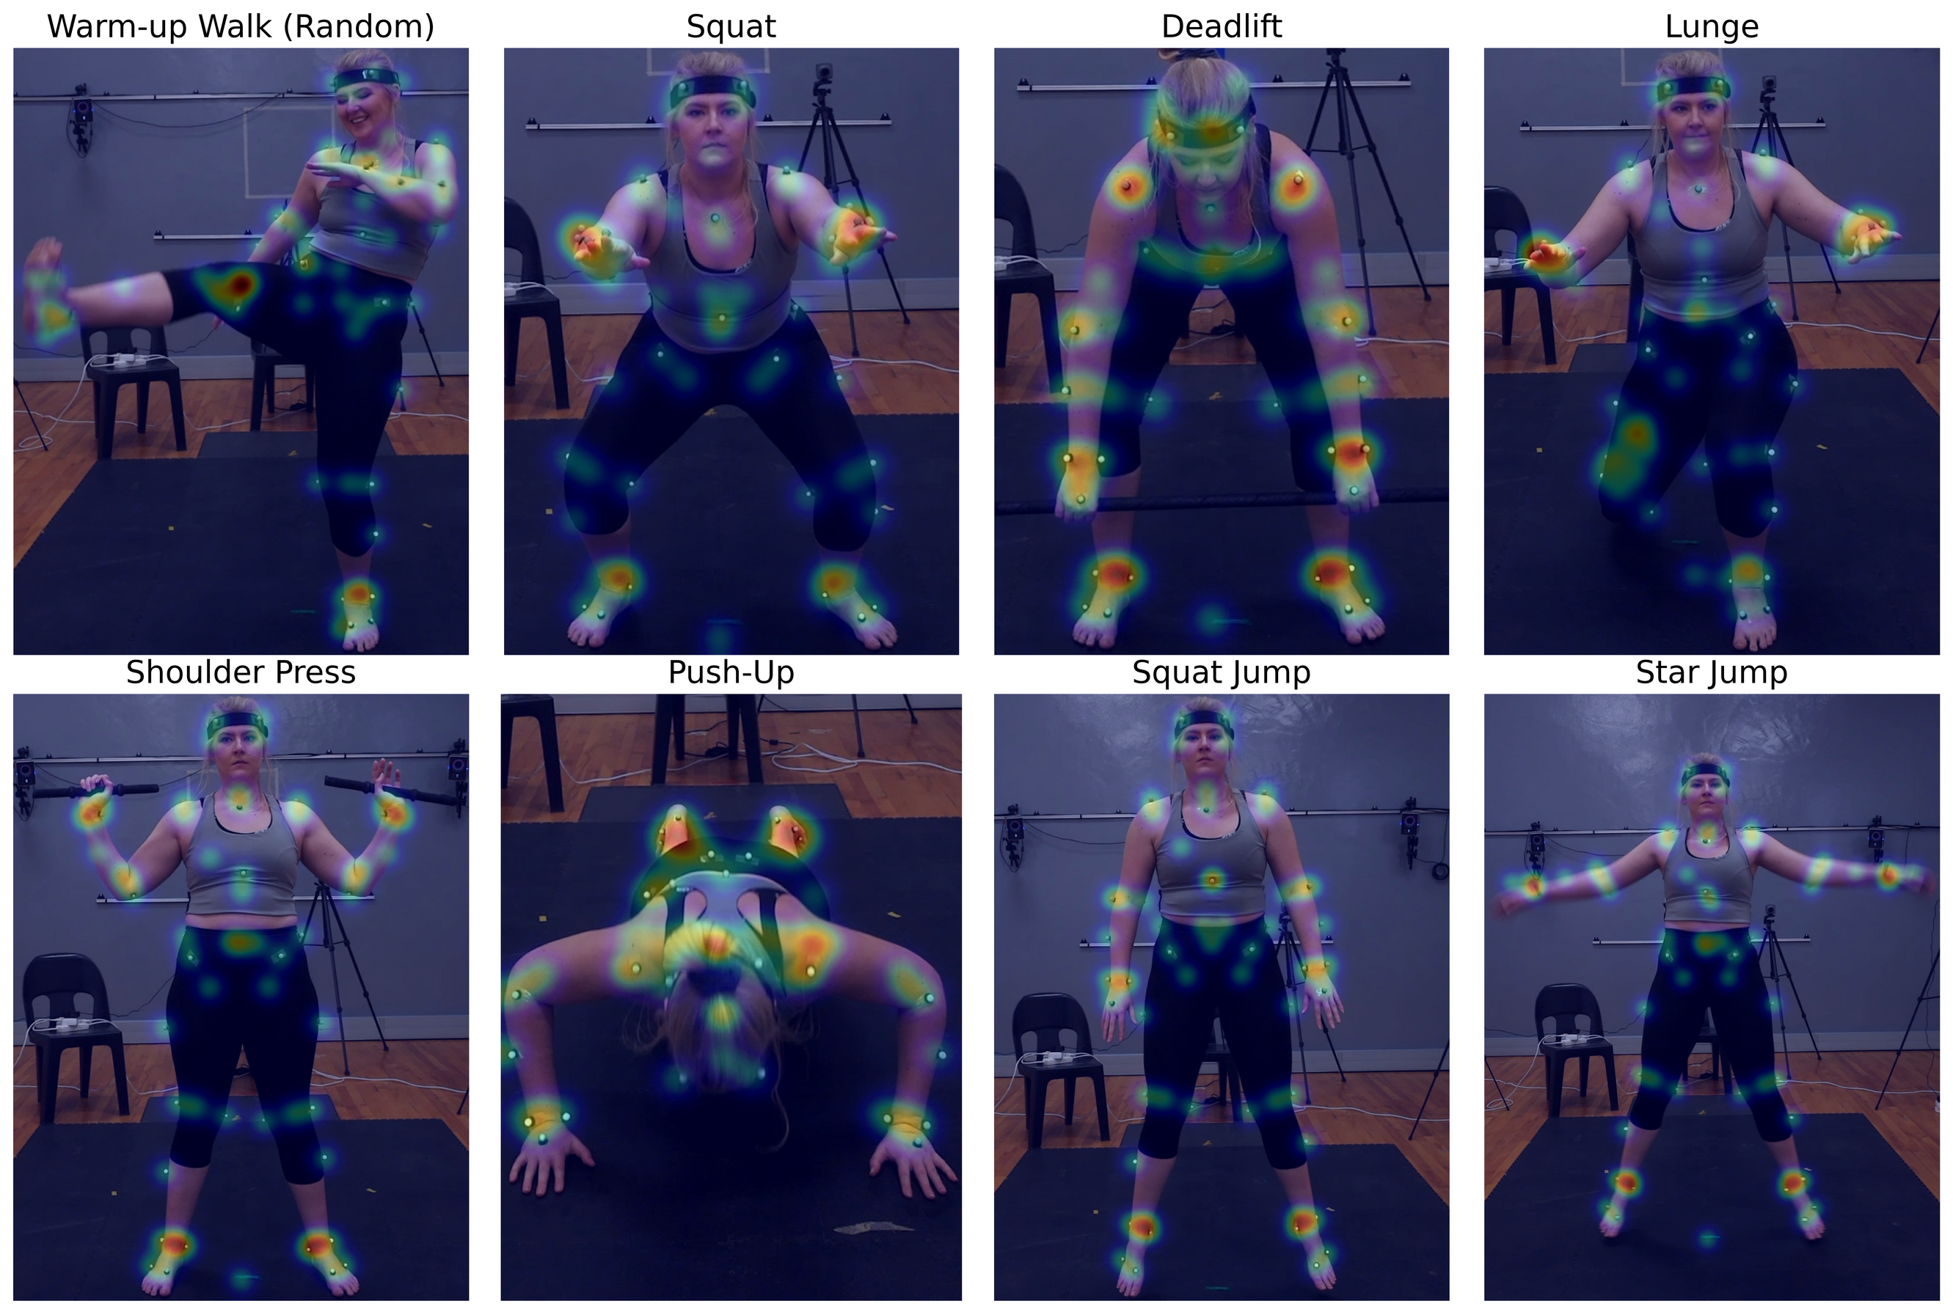
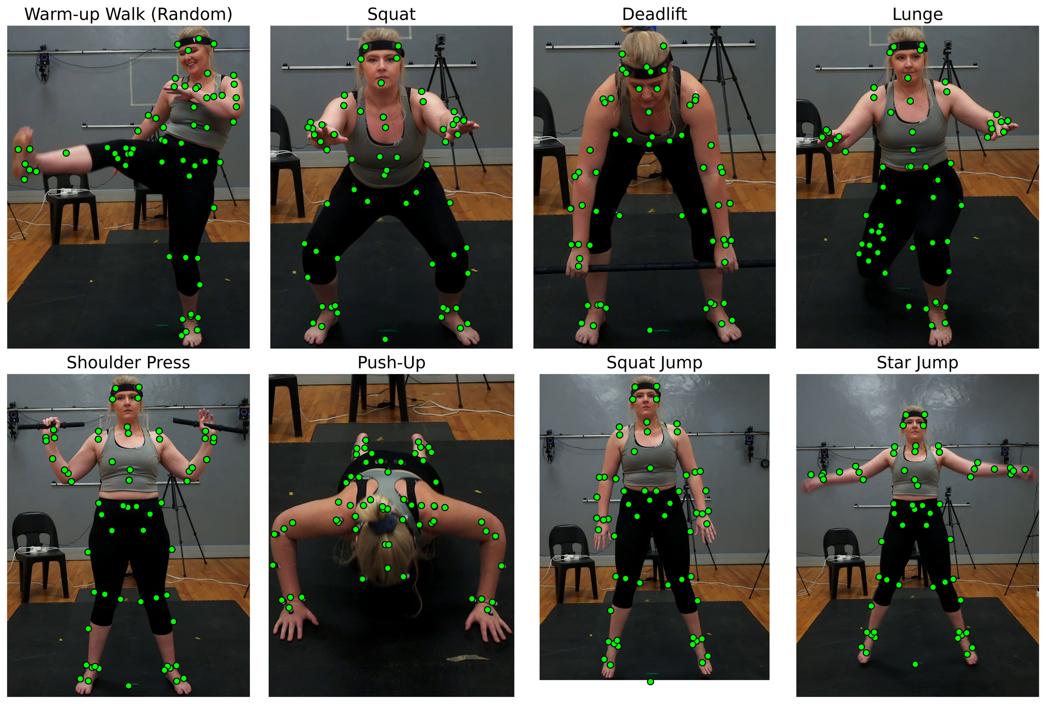
2D Pose Estimation Examples
Engineering · EyobuNjineli · Ingenieurswese
Notes:
These examples show our models in action
- heatmaps on the left showing confidence regions, keypoint predictions on the right.
Notice the dense anatomical detail we're capturing.

Slide 9
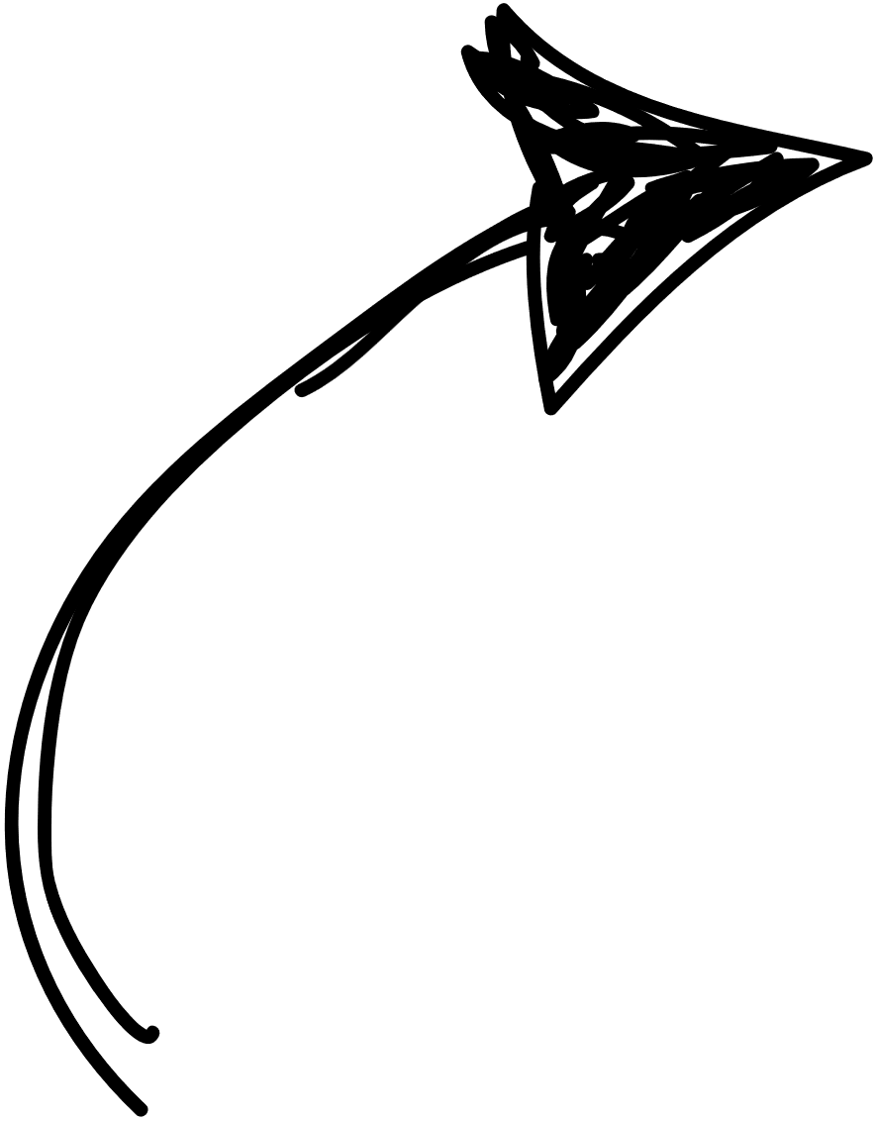
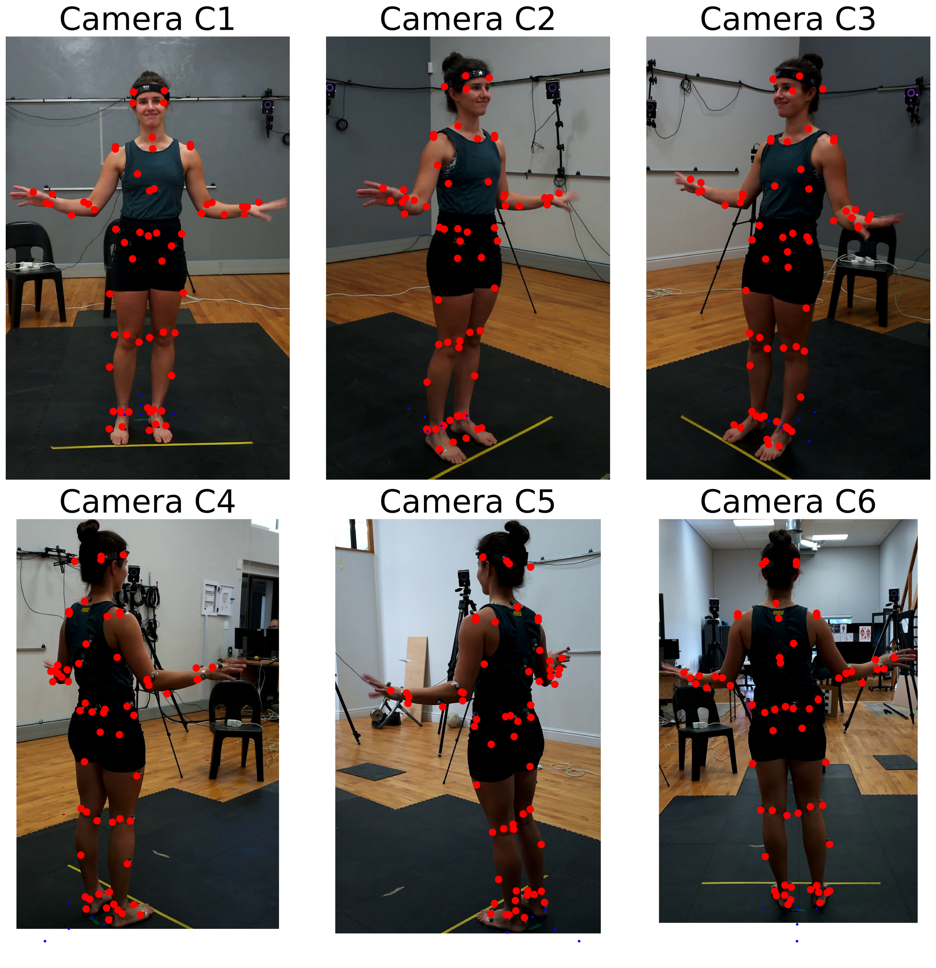
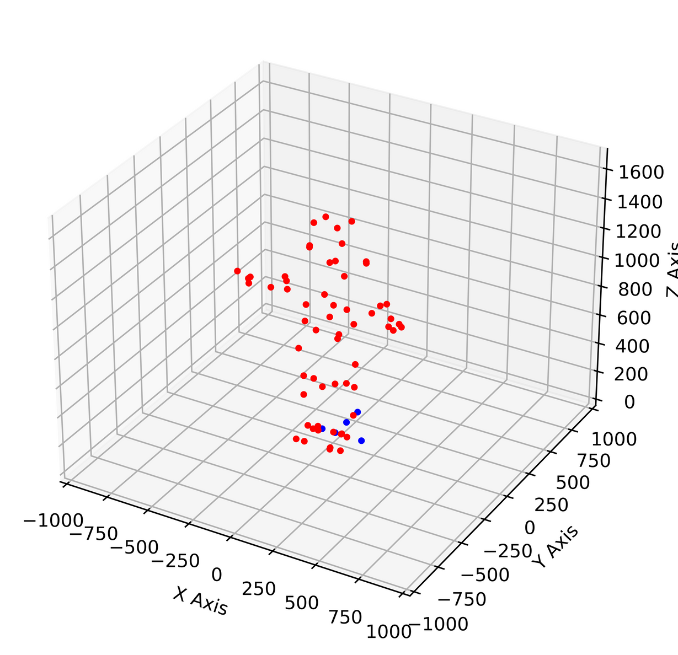
Method: 3D Triangulation
Engineering · EyobuNjineli · Ingenieurswese
Notes:
For 3D reconstruction, we used multi-camera triangulation
- three synchronized viewpoints allow us to reconstruct 3D positions from 2D predictions.

Slide 10
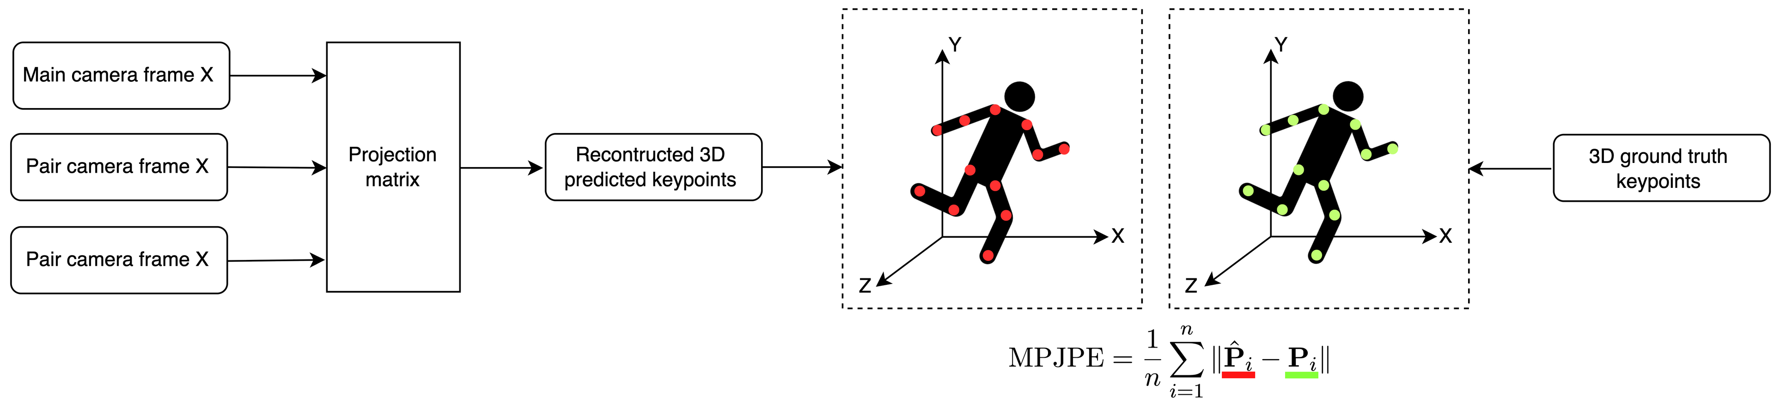
Method: 3D Evaluation
Engineering · EyobuNjineli · Ingenieurswese
Notes:
We validated 3D accuracy using mean per joint position error.
This calculates the Euclidean distance between each predicted and ground truth keypoint, then averages across all joints and frames
- essentially measuring how far off our predictions are in millimeters.

Slide 11
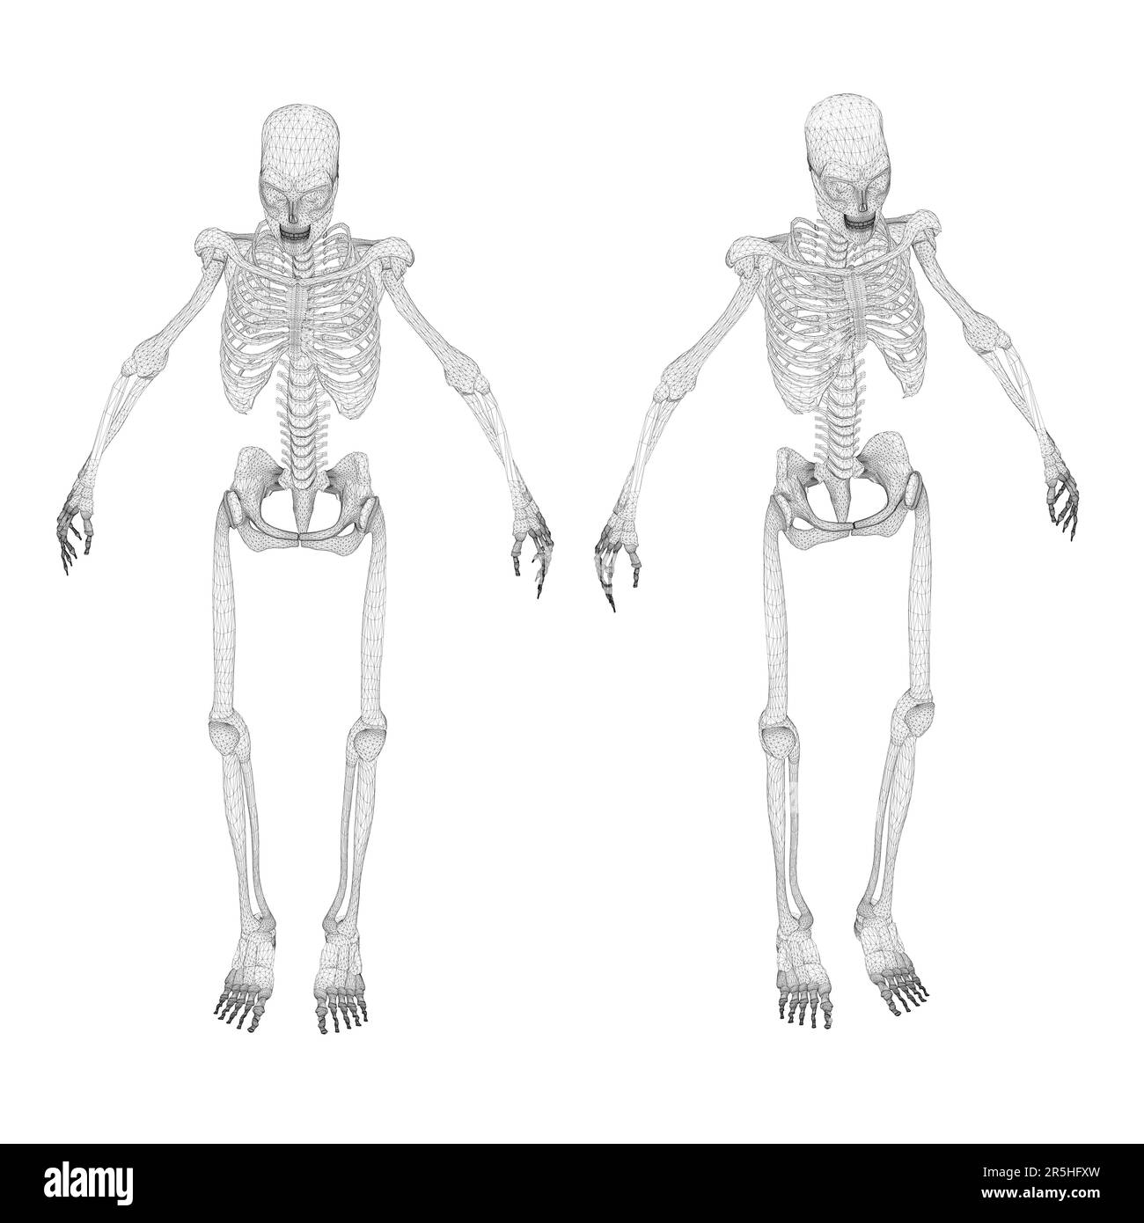
Method: Biomechanical Evaluation
Pelvis
Hip
Knee
Ankle
Foot
Engineering · EyobuNjineli · Ingenieurswese
Notes:
For biomechanical analysis, we focused on five key anatomical regions: pelvis, hip, knee, ankle, and foot.
We followed established Vicon documentation for calculating anatomical coordinate systems and joint angles, ensuring our methods align with clinical standards.

Slide 12
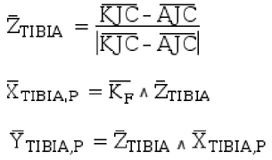
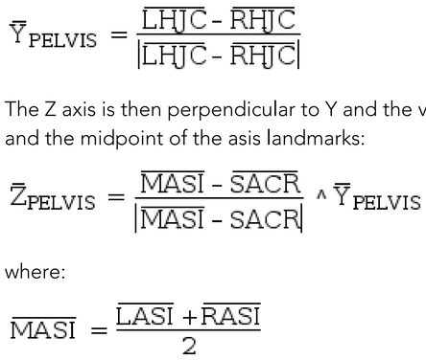
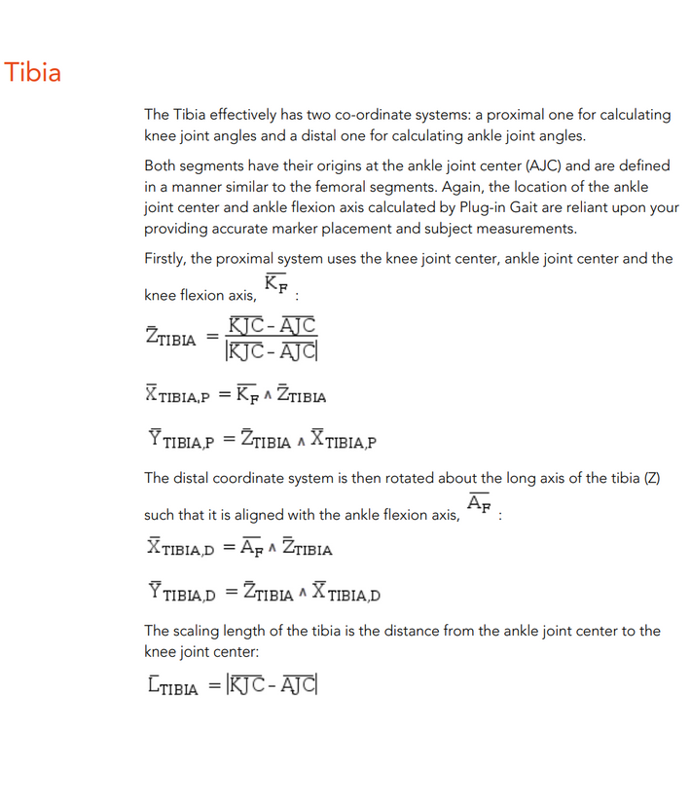
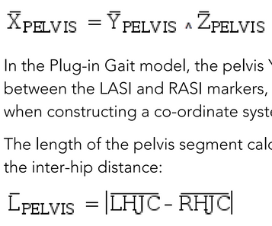
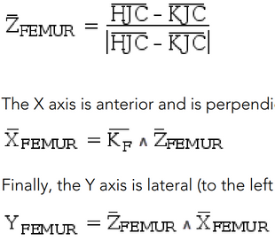
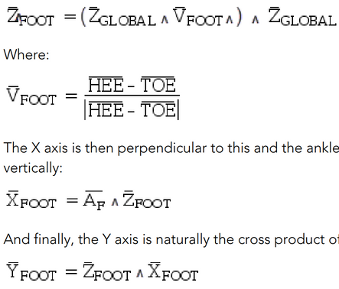
Method: Biomechanical Evaluation
Pelvis
Hip
Knee
Ankle
Foot
Engineering · EyobuNjineli · Ingenieurswese
Notes:
For biomechanical analysis, we focused on five key anatomical regions: pelvis, hip, knee, ankle, and foot.
We followed established Vicon documentation for calculating anatomical coordinate systems and joint angles, ensuring our methods align with clinical standards.

Slide 13



Method: Biomechanical Evaluation
Pelvis
RKJC
Hip
LPSI
SACR
RPSI
LHJC
RHJC
RASI
MASI
LASI
RAJC
Knee
RHJC
LHJC
RHEE
Ankle
RKNE
RKJC
LKNE
RTOE
Foot
Engineering · EyobuNjineli · Ingenieurswese
Notes:
For biomechanical analysis, we focused on five key anatomical regions: pelvis, hip, knee, ankle, and foot.
We followed established Vicon documentation for calculating anatomical coordinate systems and joint angles, ensuring our methods align with clinical standards.

Slide 14


Method: Biomechanical Evaluation
Pelvis
front
RKJC
Hip
LPSI
SACR
RPSI
LHJC
RHJC
trans
RASI
MASI
LASI
RAJC
sag
Knee
RHJC
LHJC
RHEE
Ankle
RKNE
RKJC
LKNE
RTOE
Foot
Engineering · EyobuNjineli · Ingenieurswese
Notes:
For biomechanical analysis, we focused on five key anatomical regions: pelvis, hip, knee, ankle, and foot.
We followed established Vicon documentation for calculating anatomical coordinate systems and joint angles, ensuring our methods align with clinical standards.

Slide 15
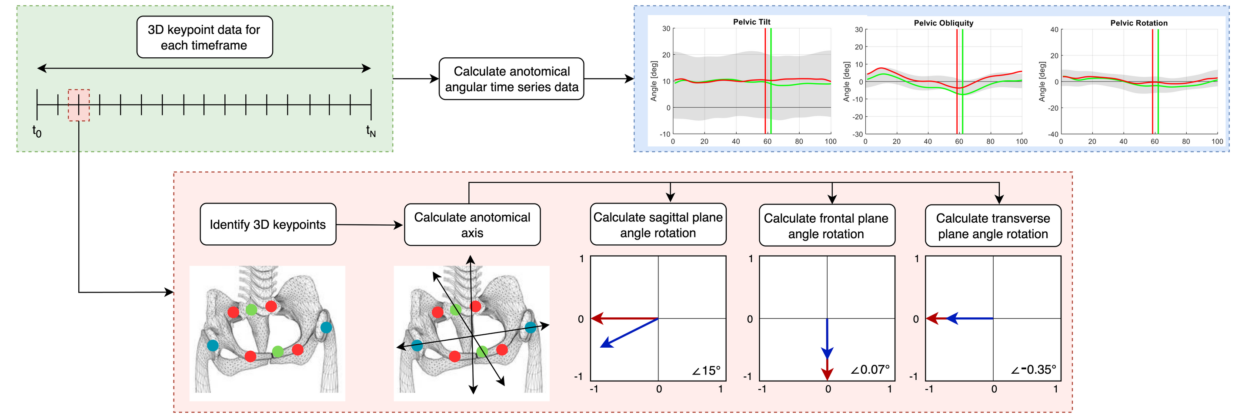
Method: Biomechanical Evaluation
Engineering · EyobuNjineli · Ingenieurswese
Notes:
Here's the core of our biomechanical evaluation process:
for each frame in a movement sequence, we identify the 3D keypoints, calculate anatomical coordinate systems, then determine joint angles across all three planes - sagittal, frontal, and transverse.
This constructs comprehensive joint angle time series data that captures the full movement dynamics.

Slide 16
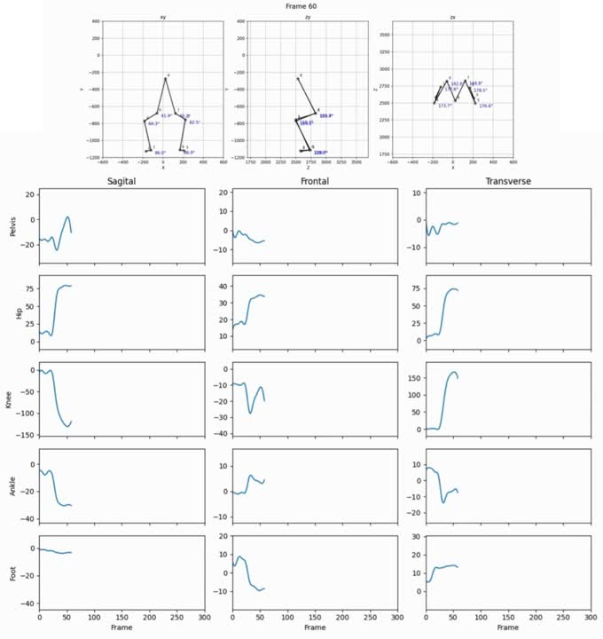
Simplified Example of Angular Time-Series data
Engineering · EyobuNjineli · Ingenieurswese
Notes:
This shows what biomechanical analysis actually looks like - joint angles changing over time during movement, captured as continuous data streams

Slide 17
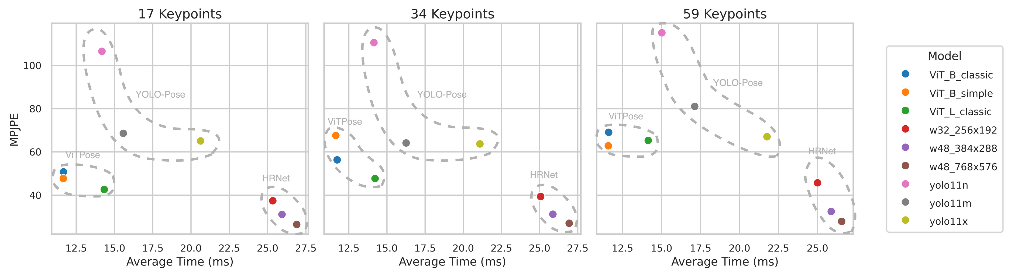
Results: Preliminary Model Evaluation
  All models fine-tuned successfully across keypoint densities
  HRNet-w48: 23.24mm average error (best performance, slowest inference)
  ViTPose variants: 35mm (~50% higher error, faster inference)
3D Results
Engineering · EyobuNjineli · Ingenieurswese
Notes:
The results were both expected and surprising.
All models fine-tuned successfully across keypoint densities with only slight loss in accuracy, proving that these architectures can adapt to complex anatomical requirements.
HRNet-w48 emerged as our accuracy champion with an average 3D error of just 23.24mm - that's remarkably close to clinical standards.
ViTPose variants showed about 50% higher error but compensated with significantly faster inference times.

Slide 18
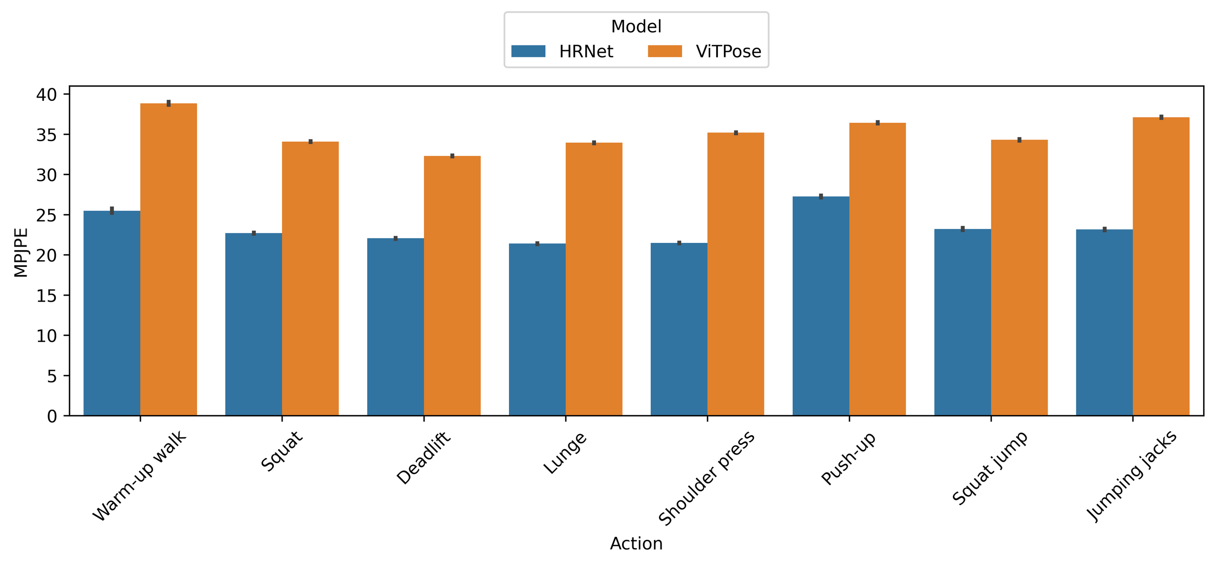
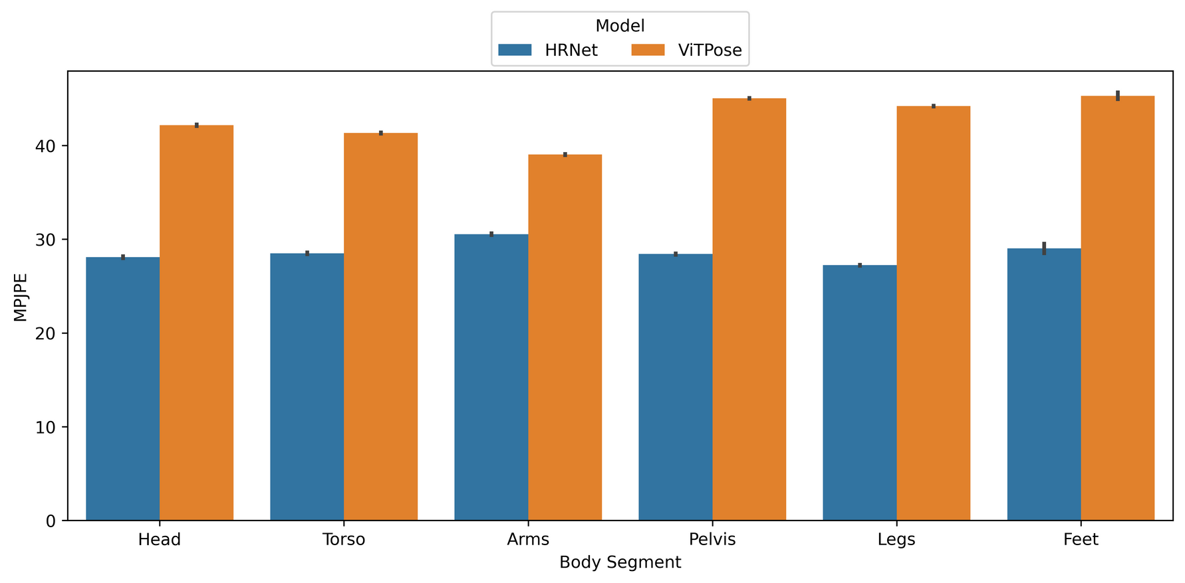
Results: 3D Performance
  Push-ups & Walk-up walks perform slightly worse
  Lower body keypoints are slightly more difficult to predict
Engineering · EyobuNjineli · Ingenieurswese
Notes:
Push-ups and walking presented particular difficulties, which makes sense when you consider the obscured views of the body and unpredictable movement patterns.
Interestingly, we found that lower body keypoints were consistently more challenging to predict.
But here's where it gets interesting - the relationship between 2D accuracy and biomechanical validity isn't always straightforward.

Slide 19
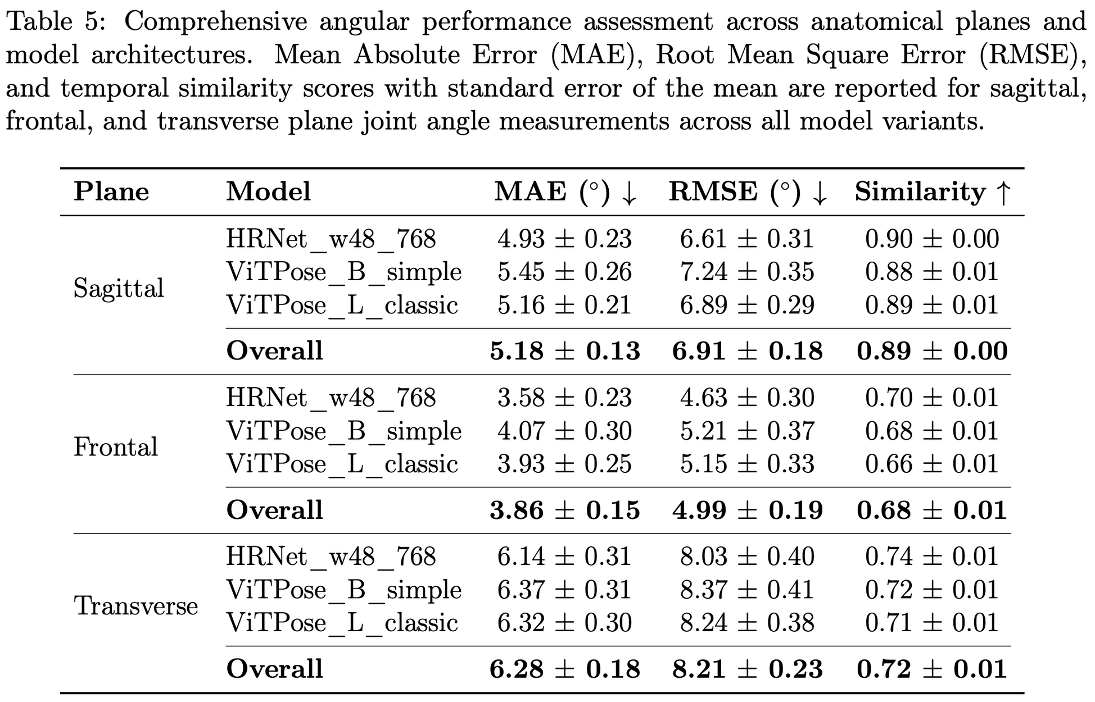
Results: Plane-Specific Biomechanical Performance
  Angular errors within clinical thresholds (<6.5°)
  Sagittal: 4.93°
  Frontal: 3.58°
  Transverse: 6.14°
  High temporal similarity (0.70-0.90) preserves movement patterns
Engineering · EyobuNjineli · Ingenieurswese
Notes:
This is where our research gets clinically relevant.
When we calculated joint angles in the sagittal, frontal, and transverse planes, we achieved angular errors well within clinical thresholds: 4.93° sagittal, 3.58° frontal, and 6.14° transverse.
More importantly, we maintained high temporal similarity - between 0.70 and 0.90 - which means our models preserved movement patterns over time.
This is crucial because biomechanical analysis isn't just about individual frames; it's about understanding movement dynamics.

Slide 20
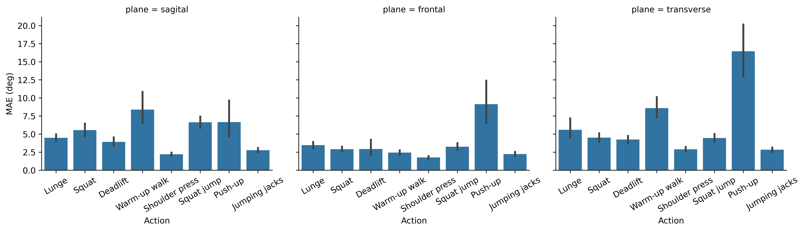
Results: Angular Performance on Specific Actions
  Structured exercises: excellent performance (2°-5°)
  Dynamic movements: good temporal preservation (0.89-0.92)
  Push-ups: identified failure case in the transverse plane (17.35°)
Engineering · EyobuNjineli · Ingenieurswese
Notes:
We did identify some failure cases.
Push-ups showed a concerning 17.35° error in the transverse plane, likely due to the obscured view of the body during the movement, highlighting that certain movement patterns and occlusion scenarios still challenge these models.
But for structured exercises and most functional movements, the results were remarkably robust.

Slide 21
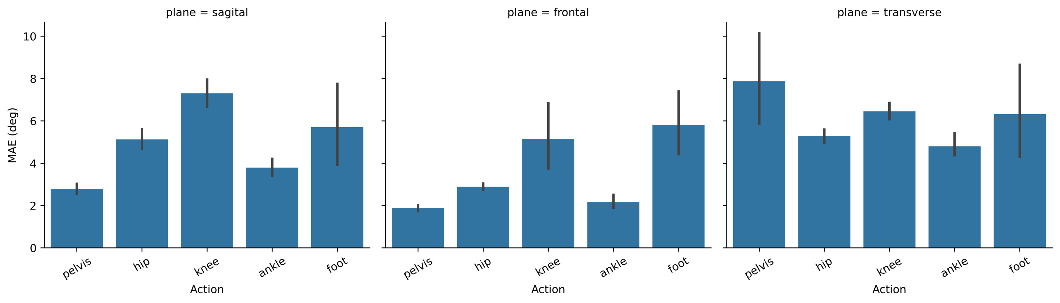
Results: Angular Performance on Specific Anatomical Regions
  Core stability joints excel: Pelvis (2.75°), Hip (5.19°) - ideal for postural assessment
  Load-bearing complexity: Knee (7.64°) highest error but preserved temporal patterns (0.95)
  Rotational challenges: Pelvis errors increase dramatically in transverse plane (8.05°)
  Clinical relevance: All major joints within acceptable thresholds for functional screening
Engineering · EyobuNjineli · Ingenieurswese
Notes:
Core stability joints like the pelvis and hip performed exceptionally well, making these methods ideal for postural assessment.
However, we did observe that pelvis errors increased dramatically in the transverse plane to 8.05°, highlighting the challenges of rotational movement detection.
The knee showed the highest overall error at 7.64°, but still maintained excellent temporal patterns.

Slide 22
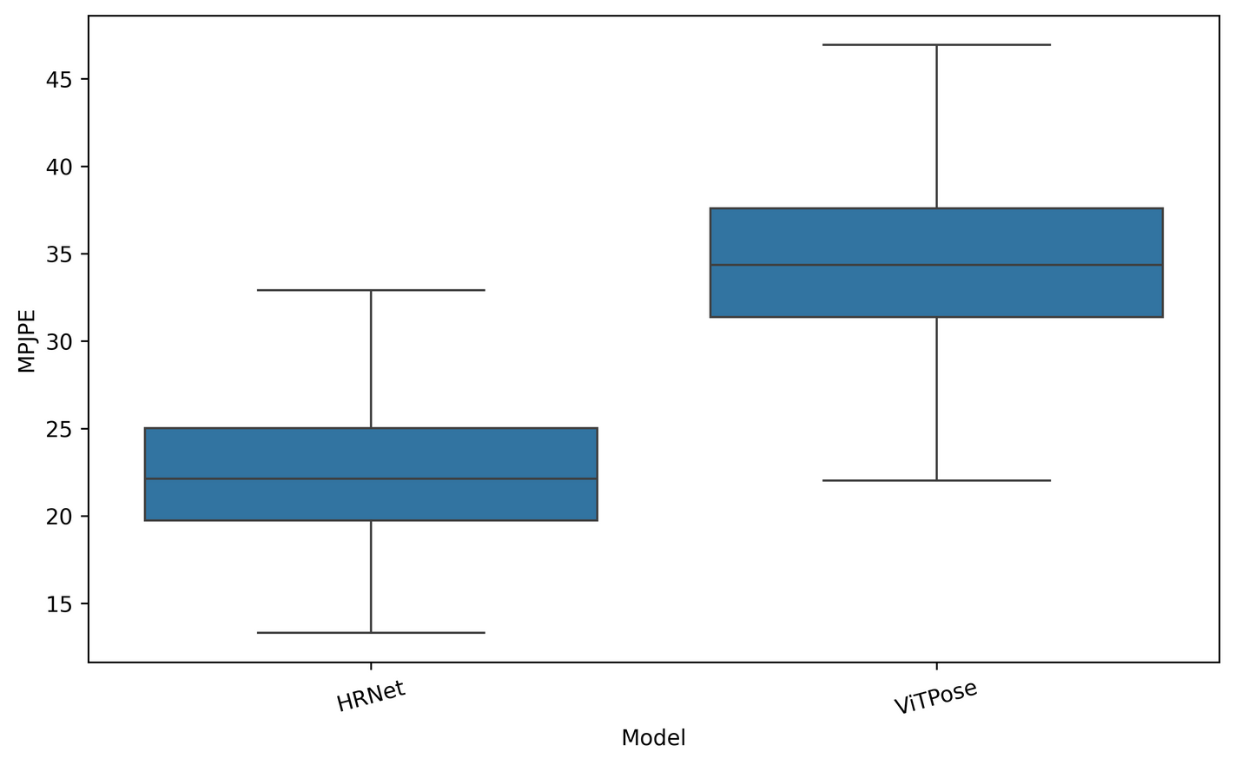
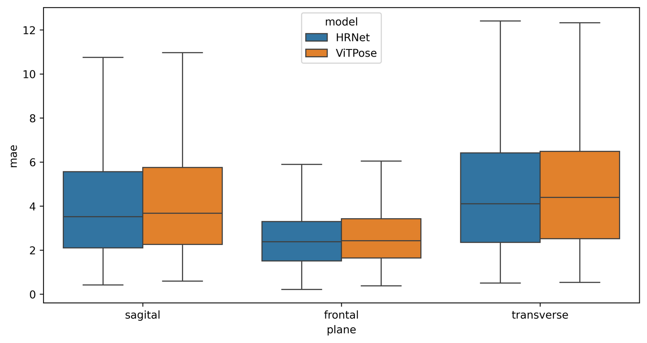
Results: 3D vs Biomechanical Validity
  3D metric: shows 50% difference
  Biomechanical metric: shows 10% difference
Engineering · EyobuNjineli · Ingenieurswese
Notes:
Here's perhaps our most important finding: conventional 3D metrics can be misleading when evaluating biomechanical applications.
While 3D reconstruction showed a 50% difference between HRNet and ViTPose, biomechanical analysis revealed only a 10% difference in actual joint angle accuracy.
This suggests that for clinical applications, we need to evaluate models based on their biomechanical output, not just their ability to place keypoints in 3D space

Slide 23
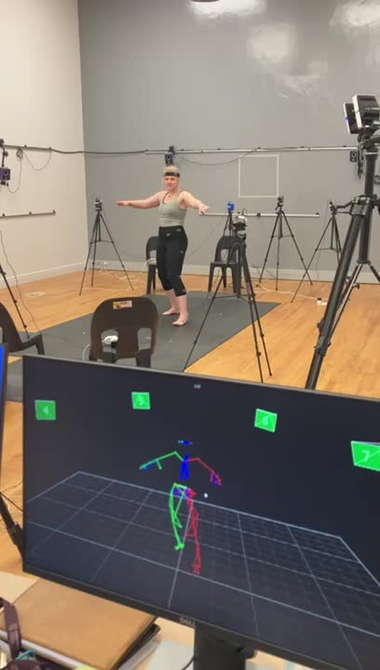
Impact & Conclusions
Clinical Considerations
  Dense keypoint adaptation: 17→59 anatomical keypoints successfully
  Clinical accuracy: <6.5° angular error
  Biomechanical validation: Conventional metrics misleading
Engineering · EyobuNjineli · Ingenieurswese
Notes:
So what does this mean practically? We've successfully demonstrated that dense keypoint adaptation is not only possible but clinically viable.
With angular errors under 6.5°, these models can provide accessible screening where motion capture is unavailable.
The clinical applications are compelling: real-time movement analysis for immediate feedback, movement quality detection for functional screening, and accessible biomechanical assessment in settings that previously required expensive laboratory equipment.
But perhaps most importantly, we've shown that biomechanical validation reveals different model characteristics than traditional computer vision metrics. This has implications for how we evaluate and select models for clinical deployment.

Slide 24
Impact & Conclusions
Clinical Considerations
  Dense keypoint adaptation: 17→59 anatomical keypoints successfully
  Clinical accuracy: <6.5° angular error
  Biomechanical validation: Conventional metrics misleading
Clinical Applications
  Accessible screening: Markerless assessment where mocap unavailable
  Real-time analysis: Immediate movement feedback capability
  Movement quality detection: Preserved temporal patterns enable functional screening
Engineering · EyobuNjineli · Ingenieurswese
Notes:
In conclusion, we can now perform clinically relevant biomechanical analysis using standard cameras and AI models.
While we're not quite ready to replace motion capture laboratories, we're definitely ready to bring biomechanical insights to places they've never been before.
The future of movement analysis might just be in your pocket.

Slide 25
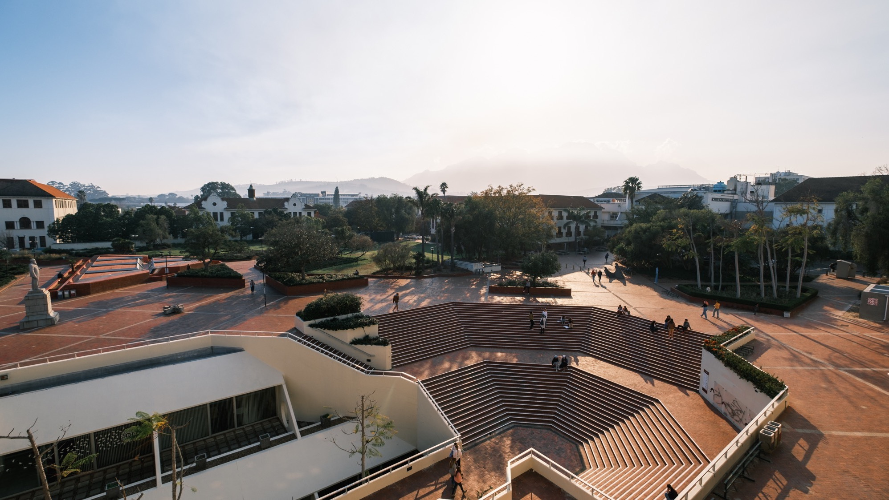
Thank you
Enkosi
Dankie
Photo by Stefan Els
Engineering · EyobuNjineli · Ingenieurswese
Notes:
Cover/End slide layout
To change the picture:
Select the picture by clicking on it near the bottom of the slide (under the title placeholder), then click on the Picture Format tab.
Click on the Change Picture icon and choose the From a File/This Device… option.
Browse and select a picture and click on the Insert button.
Use the Crop command to adjust the image.
Click on the Crop command again to apply the changes.
Remember to add image attributions to photographs or artworks.
25

